Slide 1

Neural networks
Introduction to Machine Learning – Lecture 10 Computer Science BSc Course, ELTE Faculty of Informatics
János Botzheim
Associate Professor Department of Artificial Intelligence botzheim@inf.elte.hu

Slide 2
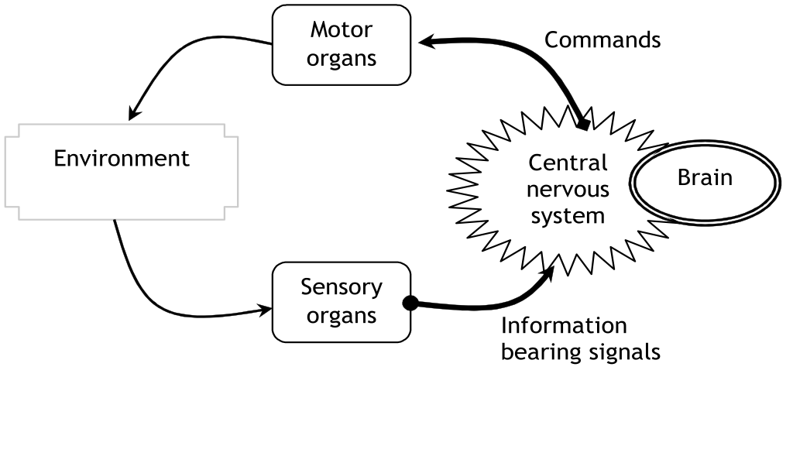
Human nervous system
Human nervous system is a very complex system capable of thinking, remembering, problem solving, making decision and etc.

Slide 3
Few data
The fundamental cellular unit of nervous system is called neuron.
A baby is born with about 10¹¹ neurons in the brain.
Neuron is a simple processing unit connected to approximately 1000 neurons. Therefore, there are approximately 10¹⁴ connections or transmission paths in the nervous system.
The estimated memory capacity of the human brain varies between 1 and 1000 terabytes (for comparison, the US Library of Congress currently stores around 10 terabytes of data).

Slide 4
Biological neurons
The function of a neuron is receiving and combining signals from other neurons through input paths called dendrites.
If the combined input signal is strong enough, the neuron fires and produces an output signal and sends the output along the axon to other neurons.
Signals from other neurons
Synapse
Soma
(Nucleus)
Fired signal
To dendrites of other neurons
Dendrites
Axon
Information flow

Slide 5
Computer vs. human nervous system
 | Computer | Human
Speed | Above 4 GHz | 40-50Hz (Neuron response time - 20-30 ms)
Operation mode | Serial mode | Parallel mode (Low speed of brain is compensated by high processing speed inside the brain)
Recognizing a person after seeing | A complicated task, depends on the background, viewing point, etc. | Half a second

Slide 6
Artificial neuron
An information processing unit that is fundamental of an artificial neural network.
A mimicking model for biological neuron.
x₁
Weight
Output signal (y)
w₁
Serve as input for other neurons
x₂
w₂
Σ
v
Neuron’s inputs
Φ(v)
x_{i}
w_{i}
Summing junction (Adder)
w_{n}
x_{n}

Slide 7
Artificial neuron
A neuron can only perform some simple information processing; therefore it is not able to solve complex problems.
However, neurons can be interconnected to deliver collective complex behavior and thus they can be used for solving complex problems.

Slide 8
Biological vs. artificial neuron
Biological neuron | Artificial neuron
Soma | Neuron
Dendrite | Input
Axon | Output
Synapse | Weight

Slide 9
Activation function (Φ)
Limits the output between two asymptotes so that it can keep neuron output within reasonable dynamic range
y
y
1
1
y=1 v>T
y=0 v<T
y = 1/(1+e^{-αv})
α: adjusts the abruptness of the function
0.5
0
T
v
0
v
Threshold or step Function
Sigmoid function

Slide 10
Single layer perceptron
Single layer perceptron was proposed by Rosenblatt in 1958 as the 1st model for learning with a teacher (i.e., supervised learning).
His perceptron was based on McCulloch-Pitts model of neuron.

Slide 11
Single layer perceptron
Used for solving linearly separable patterns.
This caused serious disappointment in the neural network community and put neural network researchers in a dark period (1970s).
However, this statement was not correct in general, because multilayer perceptrons are capable of separating linearly inseparable variables (including XOR problem).
Class
C₁
Class
C₁
Class
C₂
Class
C₂
linearly separable patterns
nonlinearly separable patterns

Slide 12
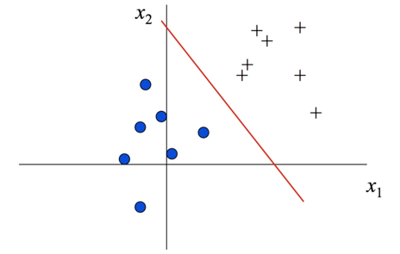
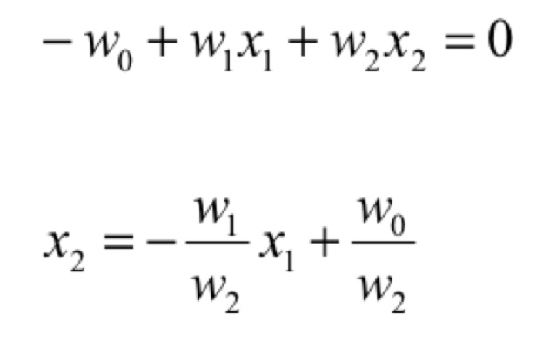
Linear separability
Consider the following example with two inputs (x1,x2)
Can the trained network define the “separation line”?
What is its equation?

Slide 13
Linear separability

Slide 14
Linear separability

Slide 15
Linear separability

Slide 16
Implementing logic gates
We can use McCulloch-Pitts neurons to implement the basic logic gates
All we need to do is find the appropriate connection weights and neuron threshold to produce the right outputs for each set of inputs
We shall see explicitly how one can construct simple networks that perform NOT, AND, and OR.
It is then a well known result from logic that we can construct any logical function from these three operations
The resulting networks, however, will usually have a much more complex architecture that a simple Perceptron
We generally want to avoid decomposing complex problems into simple logic gates, by finding the weights and thresholds that work directly in a Perceptron architecture

Slide 17
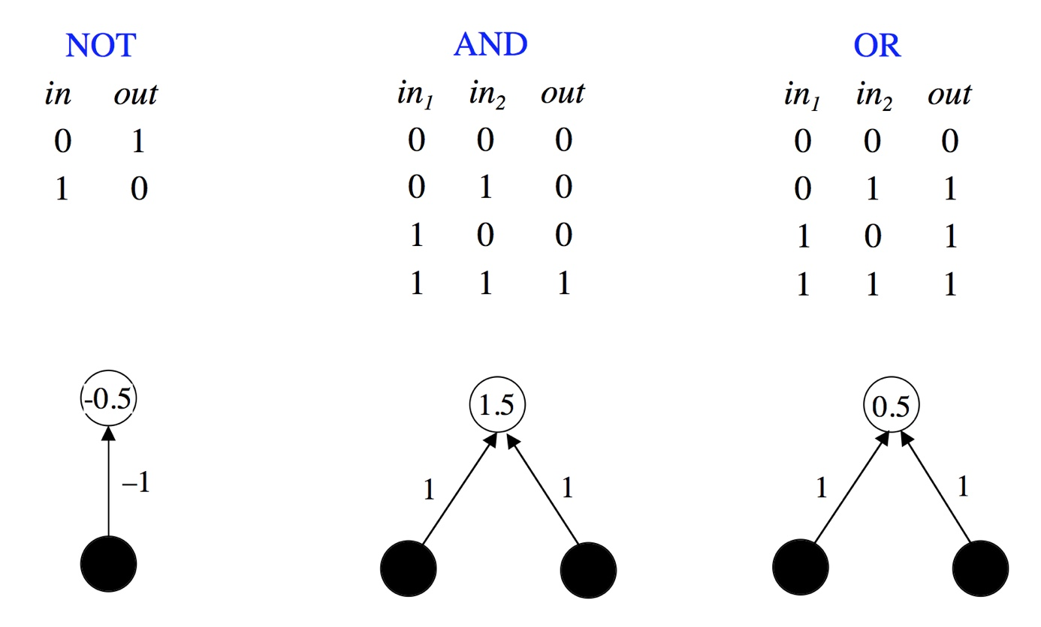
Implementation of logical NOT, AND, and OR
In each case we have inputs in_{i} and output out, and need to determine the weights and thresholds

Slide 18
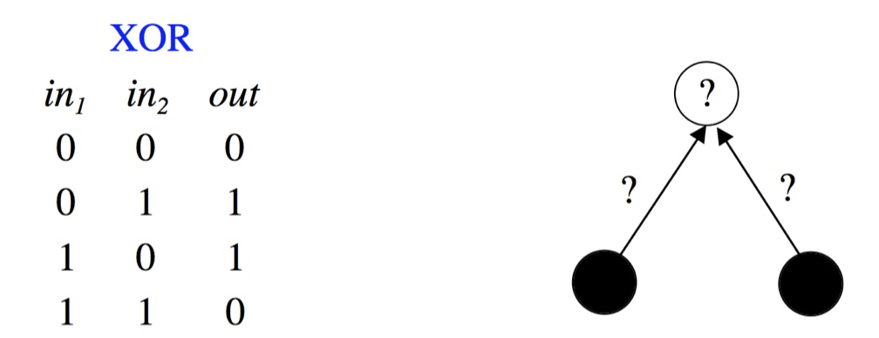
The need to find weights analytically
Constructing simple networks by hand is one thing. But what about harder problems?
For example:
How long do we keep looking for a solution?
We need to be able to calculate appropriate parameters rather than looking for solutions by trial and error.
Each training pattern produces a linear inequality for the output in terms of the inputs and the network parameters. These can be used to compute the weights and thresholds.

Slide 19
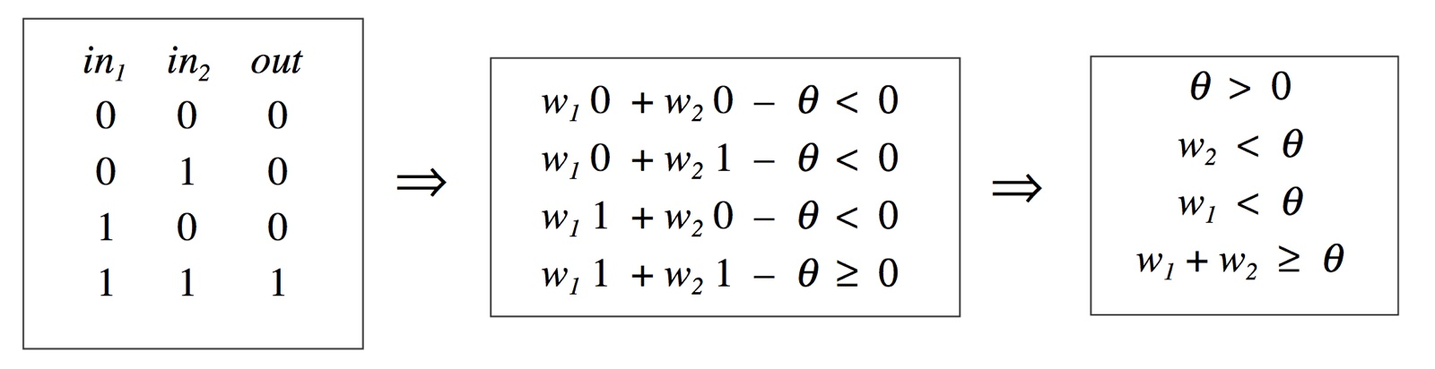
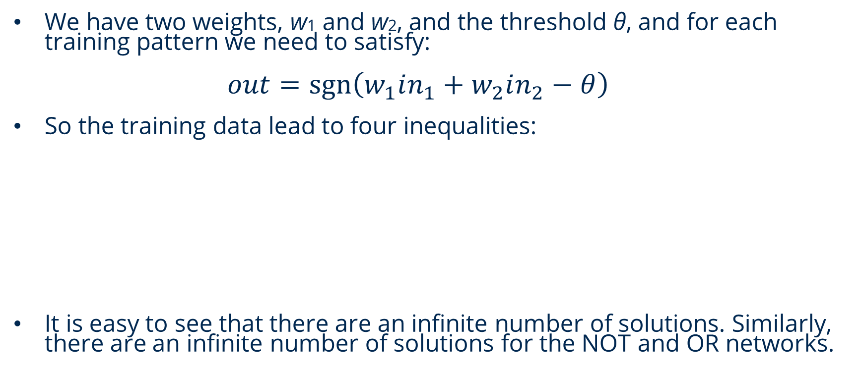
Finding weights analytically for the AND network
We have two weights, w1 and w2, and the threshold θ, and for each training pattern we need to satisfy: $out=\operatorname{sgn}\left(w_{1}in_{1}+w_{2}in_{2}−θ\right)$
So the training data lead to four inequalities:
It is easy to see that there are an infinite number of solutions. Similarly, there are an infinite number of solutions for the NOT and OR networks.

Slide 20
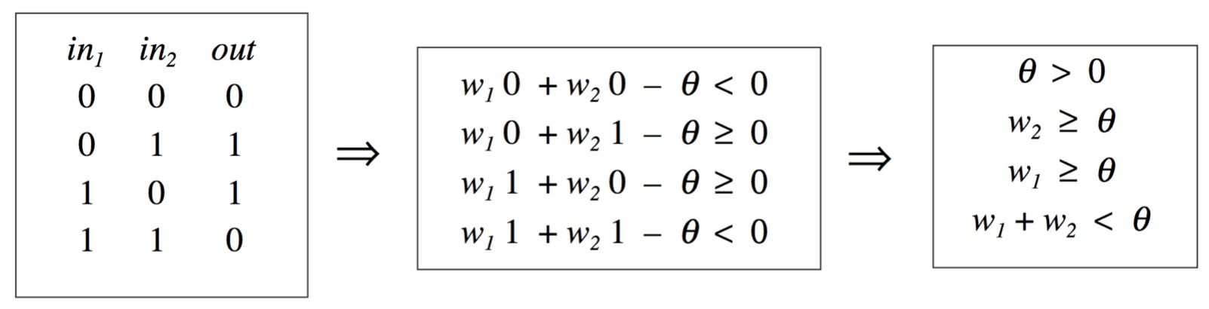
Limitations of simple perceptrons
We can follow the same procedure for the XOR network:
Clearly the second and third inequalities are incompatible with the fourth, so there is in fact no solution. We need more complex networks, e.g. that combine together many simple networks, or use different activation/thresholding/transfer functions.
It then becomes much more difficult to determine all the weights and thresholds by hand.

Slide 21
Limitations of simple perceptrons
We can follow the same procedure for the XOR network:
Clearly the second and third inequalities are incompatible with the fourth, so there is in fact no solution. We need more complex networks, e.g. that combine together many simple networks, or use different activation/thresholding/transfer functions.
It then becomes much more difficult to determine all the weights and thresholds by hand.

Slide 22
Training of a perceptron
The algorithm for training a perceptron
Initialization
Activation
Weight learning
Iteration

Slide 23
Perceptron training
1) Initialization
Set initial weights w₁, w₂, …, w_{m}
Set the threshold θ to a random number in the range [-0.5, 0.5]
Set the learning rate η to a positive value less than 1
x₁
w₁
w₂
y
x₂
w₃
x₃
w_{m}
x_{m}

Slide 24
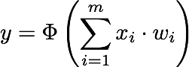
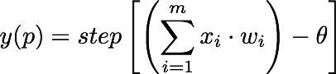
Perceptron training
2) Activation
Calculate the actual output at the iteration p=1
output:
Activation function:
Threshold/step function (or sign function)
output:

Slide 25
Perceptron training
3) Weight training
Update the weights of the perceptron
new weight w_{i}(p+1) = w_{i}(p) + Δw_{i}(p)
weight correction Δw_{i}(p) = η.x_{i}(p).e(p)
error e(p) = d(p) - y(p)

Slide 26
Perceptron training
4) Iteration
Increase iteration p by one, go back to Step 2 and repeat the process until convergence
p=2
Activation
Weight training $wi(p+1) = wi(p) + ∆wi(p$)
p=3
Activation
Weight training
……

Slide 27
An example
Train a perceptron to perform logical operation AND
Epoch | Iteration | Inputs |  | Initial weights |  | Desired output | Actual output | Error | Final weights
 | p | x₁(p) | x₂(p) | w₁(p) | w₂(p) | d(p) | y(p) | e(p) | w₁(p+1) | w₂(p+1)
1 | 1 | 0 | 0 | 0.3 | -0.1 | 0 | 0 | 0 | 0.3 | -0.1
 | 2 | 0 | 1 | 0.3 | -0.1 | 0 | 0 | 0 | 0.3 | -0.1
 | 3 | 1 | 0 | 0.3 | -0.1 | 0 | 1 | -1
 | 4 | 1 | 1

Slide 28
An example
1) Initialization
1 epoch has 4 possible input patterns: 00, 01, 10, 11
Initial weights are given w₁ = 0.3, w₂ = -0.1; θ=0.2, η=0.1
Epoch | Iteration | Inputs |  | Initial weights |  | Desired output | Actual output | Error | Final weights
 | p | x₁(p) | x₂(p) | w₁(p) | w₂(p) | d(p) | y(p) | e(p) | w₁(p+1) | w₂(p+1)
1 | 1 | 0 | 0 | 0.3 | -0.1
 | 2 | 0 | 1
 | 3 | 1 | 0
 | 4 | 1 | 1

Slide 29
An example
2) Activation
Actual output
y = step[ (0(0.3)+0(-0.1)) – 0.2] = step[-0.2] = 0
Epoch | Iteration | Inputs |  | Initial weights |  | Desired output | Actual output | Error | Final weights
 | p | x₁(p) | x₂(p) | w₁(p) | w₂(p) | d(p) | y(p) | e(p) | w₁(p+1) | w₂(p+1)
1 | 1 | 0 | 0 | 0.3 | -0.1 |  | 0
 | 2 | 0 | 1
 | 3 | 1 | 0
 | 4 | 1 | 1

Slide 30
Example
3) Weight training
AND operation for inputs 00 is 0
Error e(p) = d(p) – y(p) = 0 – 0 = 0
Epoch | Iteration | Inputs |  | Initial weights |  | Desired output | Actual output | Error | Final weights
 | p | x₁(p) | x₂(p) | w₁(p) | w₂(p) | d(p) | y(p) | e(p) | w₁(p+1) | w₂(p+1)
1 | 1 | 0 | 0 | 0.3 | -0.1 | 0 | 0 | 0
 | 2 | 0 | 1
 | 3 | 1 | 0
 | 4 | 1 | 1

Slide 31
Example
3) Weight training
For w₁: Δw₁(p) = η.x₁(p).e(p) = 0.1(0)(0) = 0
w₁(p+1) = w₁(p) + Δw₁(p) = 0.3 + 0 = 0.3
For w₂ in similar way, w₂(p+1) = -0.1
Epoch | Iteration | Inputs |  | Initial weights |  | Desired output | Actual output | Error | Final weights
 | p | x₁(p) | x₂(p) | w₁(p) | w₂(p) | d(p) | y(p) | e(p) | w₁(p+1) | w₂(p+1)
1 | 1 | 0 | 0 | 0.3 | -0.1 | 0 | 0 | 0 | 0.3 | -0.1
 | 2 | 0 | 1
 | 3 | 1 | 0
 | 4 | 1 | 1

Slide 32
Example
4) Iteration
p+1 = 2
Repeat steps 2, 3, 4……until convergence
Epoch | Iteration | Inputs |  | Initial weights |  | Desired output | Actual output | Error | Final weights
 | p | x₁(p) | x₂(p) | w₁(p) | w₂(p) | d(p) | y(p) | e(p) | w₁(p+1) | w₂(p+1)
1 | 1 | 0 | 0 | 0.3 | -0.1 | 0 | 0 | 0 | 0.3 | -0.1
 | 2 | 0 | 1 | 0.3 | -0.1
 | 3 | 1 | 0
 | 4 | 1 | 1

Slide 33
Example
Answer for Epoch 1
Epoch | Iteration | Inputs |  | Initial weights |  | Desired output | Actual output | Error | Final weights
 | p | x₁(p) | x₂(p) | w₁(p) | w₂(p) | d(p) | y(p) | e(p) | w₁(p+1) | w₂(p+1)
1 | 1 | 0 | 0 | 0.3 | -0.1 | 0 | 0 | 0 | 0.3 | -0.1
 | 2 | 0 | 1 | 0.3 | -0.1 | 0 | 0 | 0 | 0.3 | -0.1
 | 3 | 1 | 0 | 0.3 | -0.1 | 0 | 1 | -1 | 0.2 | -0.1
 | 4 | 1 | 1 | 0.2 | -0.1 | 1 | 0 | 1 | 0.3 | 0.0

Slide 34
Example
Answer for Epoch 2
Epoch | Iteration | Inputs |  | Initial weights |  | Desired output | Actual output | Error | Final weights
 | p | x₁(p) | x₂(p) | w₁(p) | w₂(p) | d(p) | y(p) | e(p) | w₁(p+1) | w₂(p+1)
2 | 5 | 0 | 0 | 0.3 | 0.0 | 0 | 0 | 0 | 0.3 | 0.0
 | 6 | 0 | 1 | 0.3 | 0.0 | 0 | 0 | 0 | 0.3 | 0.0
 | 7 | 1 | 0 | 0.3 | 0.0 | 0 | 1 | -1 | 0.2 | 0.0
 | 8 | 1 | 1 | 0.2 | 0.0 | 1 | 1 | 0 | 0.2 | 0.0

Slide 35
Example
Answer for Epoch 5
Epoch | Iteration | Inputs |  | Initial weights |  | Desired output | Actual output | Error | Final weights
 | p | x₁(p) | x₂(p) | w₁(p) | w₂(p) | d(p) | y(p) | e(p) | w₁(p+1) | w₂(p+1)
5 | 17 | 0 | 0 | 0.1 | 0.1 | 0 | 0 | 0 | 0.1 | 0.1
 | 18 | 0 | 1 | 0.1 | 0.1 | 0 | 0 | 0 | 0.1 | 0.1
 | 19 | 1 | 0 | 0.1 | 0.1 | 0 | 0 | 0 | 0.1 | 0.1
 | 20 | 1 | 1 | 0.1 | 0.1 | 1 | 1 | 0 | 0.1 | 0.1

Slide 36
Artificial neural networks
Artificial neural network is a data processing system consisting of a large number of simple, highly interconnected processing elements (artificial neurons) in an architecture inspired by the structure of the cerebral cortex of the brain to yield a network with rather complex behavior.
In ANN, neurons (processing elements) are organized into a sequence of layers with full or partial connection between the layers.
For simplicity, usually the neurons in the same layer have the same activation function.

Slide 37
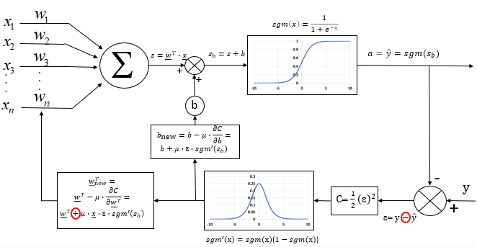
Neuron
$$μ:learning parameter$$
$$a:activation$$
$$\hat{y}:estimated output$$
$$y:desired output$$
$$\underline{x}:inputs$$

Slide 38
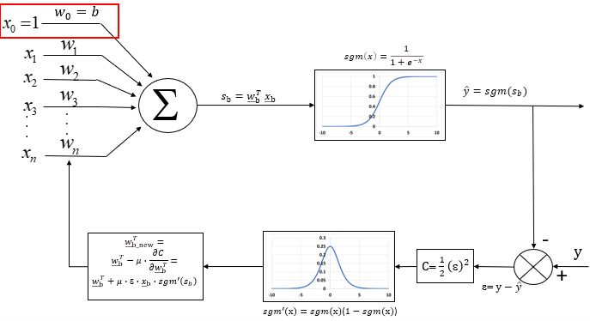
Neuron
In case of number of layers > 2 during the backpropagation
$${\underline{w}}_{b} !=\underline{w}$$

Slide 39
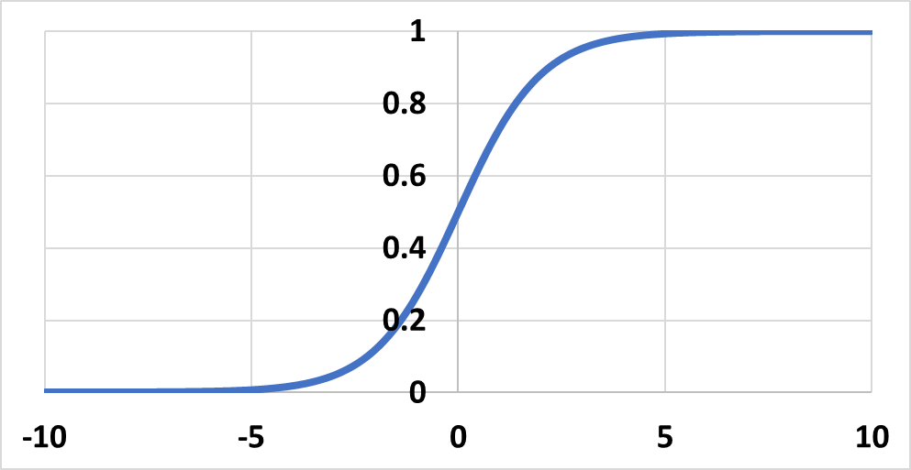
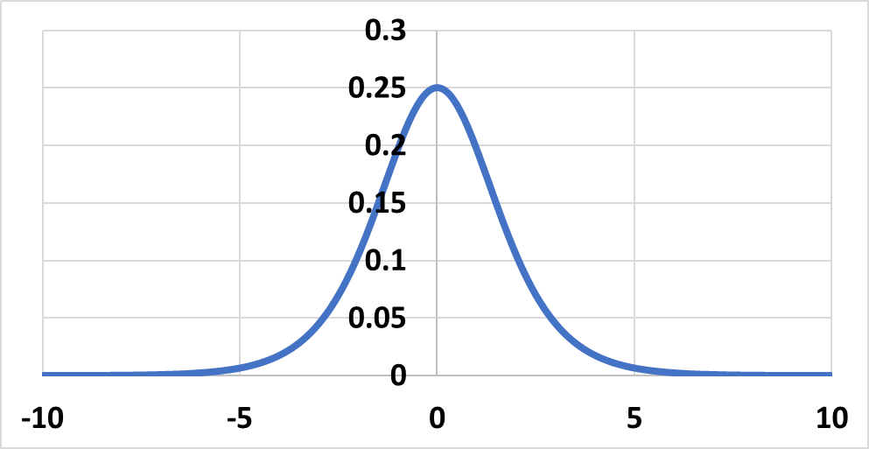
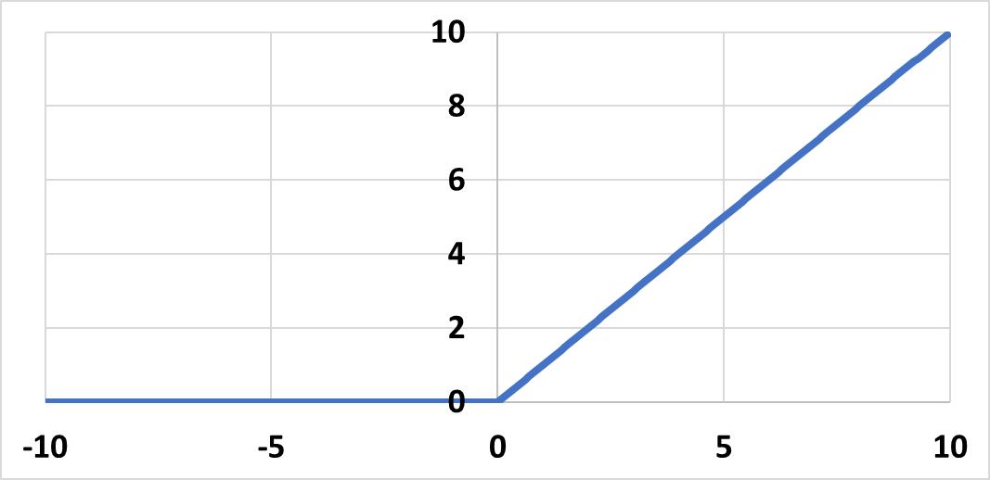
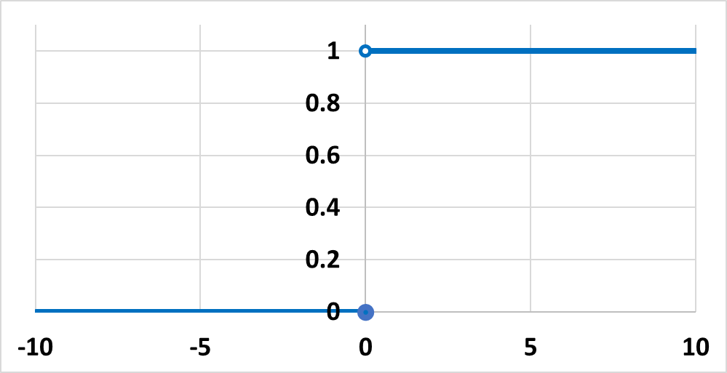
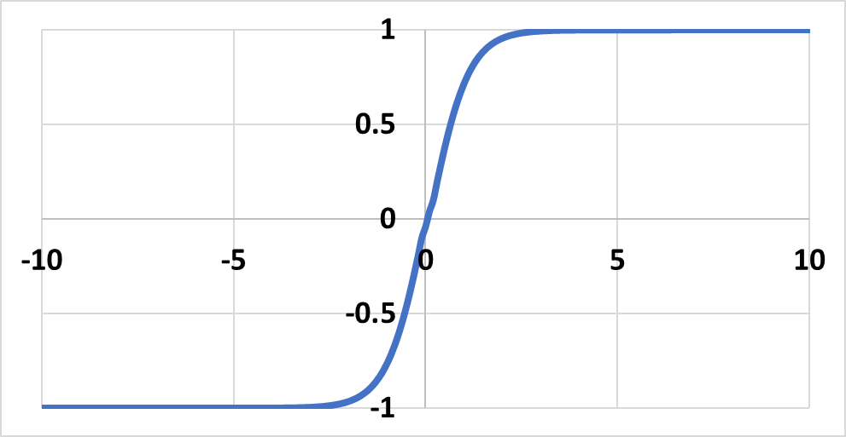
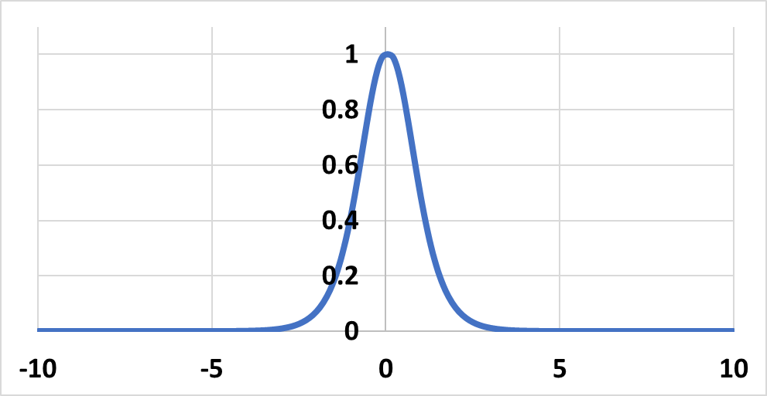
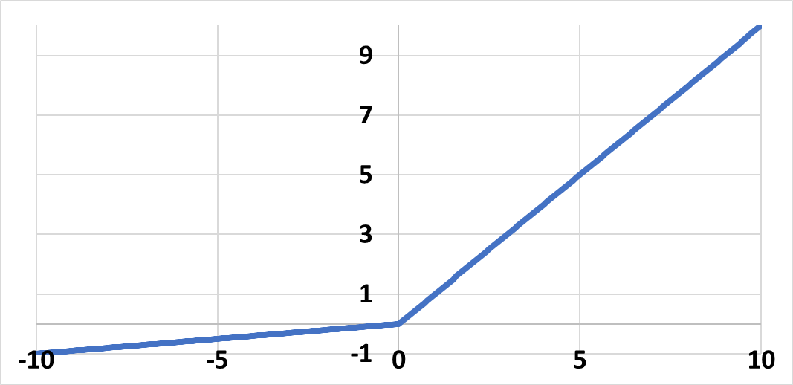
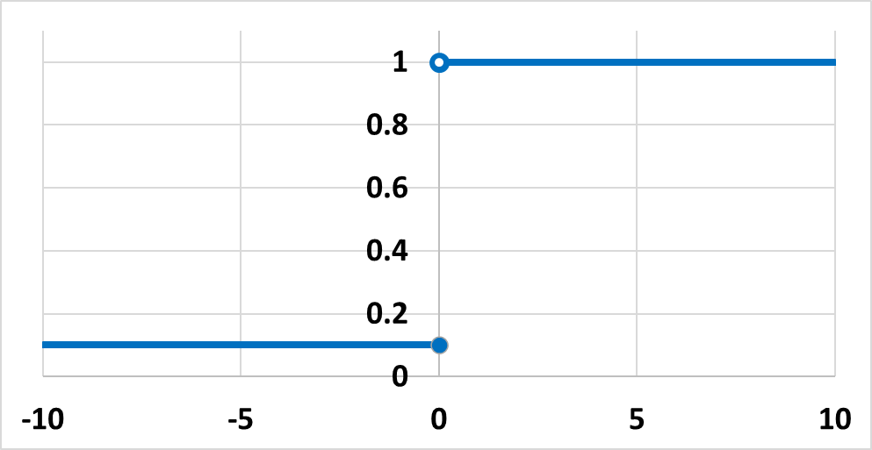
Activation function
Equation | Graph | Derivative | Graph
Sigmoid
Rectifier Linear Unit (ReLU)
Tanh
Leaky ReLU
$$sgm^{′}\left(x\right)=$$ $sgm\left(\text{x}\right)$($1−sgm\left(\text{x}\right)$)
$$sgm\left(x\right)=\frac{1}{1+e^{−x}}$$
$$ReLU′\left(x\right)=\left\{\begin{aligned}0, \\ 1,\end{aligned} \begin{matrix}if x<0 \\ if x≥0\end{matrix}\right.$$
$$ReLU\left(x\right)=\left\{\begin{aligned}0, \\ x,\end{aligned} \begin{matrix}if x<0 \\ ifx≥0\end{matrix}\right.$$
$$tanh\left(x\right)=\frac{e^{2x}−1}{e^{2x}+1}$$
$$tanh^{′}\left(x\right)=1−{tanh⁡(x)}^{2}$$
$$0.1, if x<0$$
$$LReLU\left(x\right)=\left\{\begin{aligned}0.1x, \\ x,\end{aligned} \begin{matrix}if x<0 \\ ifx≥0\end{matrix}\right.$$
$$LReLU′\left(x\right)=$$
1$, if x≥0$

Slide 40
Artificial neural networks
In terms of density, 2 important groups can be distinguished in a first approximation
Fully Connected Artificial Neural Networks All neurons in a layer are connected to all neurons in the next layer.
Advantage:
simple architecture
maximizes the potential of the network size
Disadvantage: (for large networks)
requires a lot of memory
requires a lot of computation
Partially coupled artificial neural networks All neurons in a layer are connected to only a few neurons in the next layer.

Slide 41
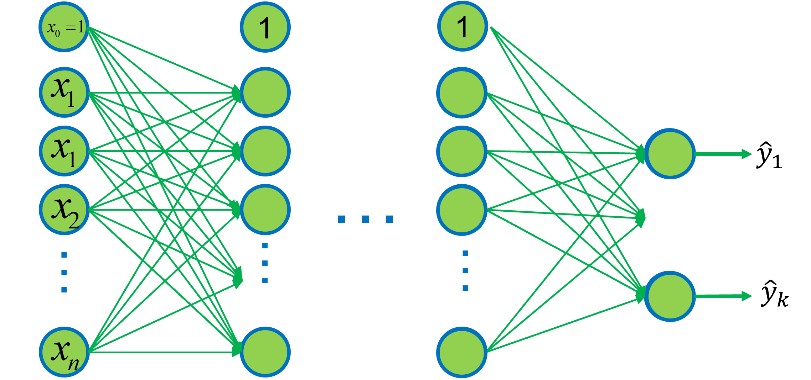
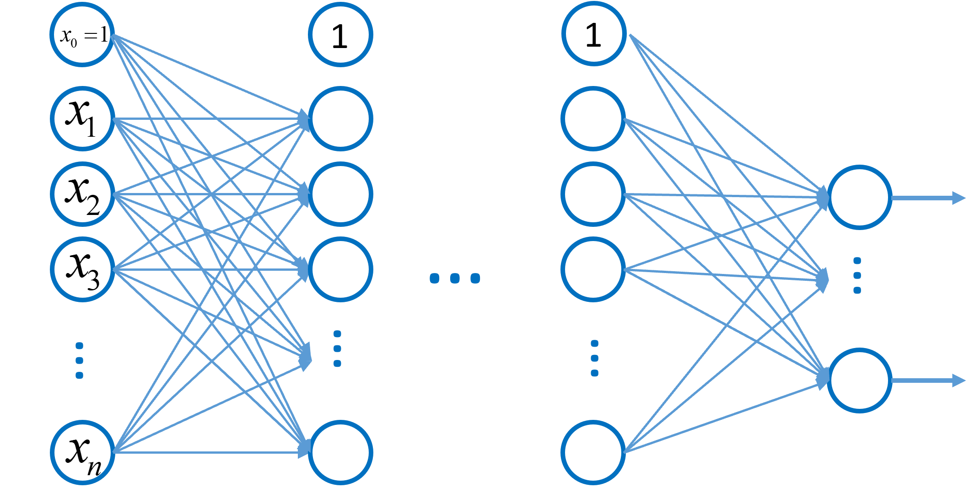
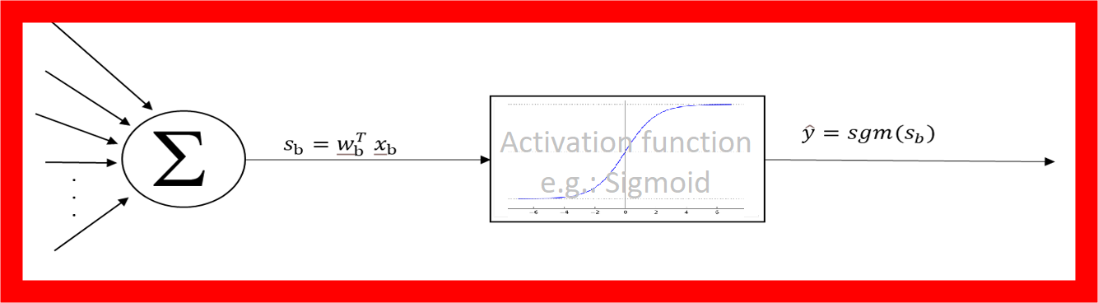
Fully connected ANN
The input to neural networks is determined by the available data and the preparation of the data.
Its output is determined by the target task.
The depth of its hidden layer is determined by its decision complexity.
Its width is determined by the amount of data needed for decisions.
In general, the appropriate dimensions of the network cannot be determined in advance.
Input layer
Hidden layer
Output layer

Slide 42
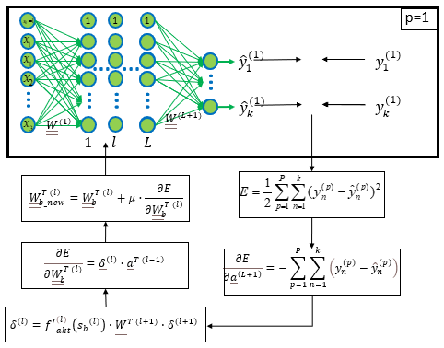
Training of fully connected ANN
In a learning cycle, we consider a number "P" of inputs (x) and corresponding outputs ($\hat{y}$).
The pair of output and expected output (y) is compared and an error function (E) is defined based on it.
The error is propagated backwards from layer to layer (L->1) taking advantage of the fact that the auxiliary parameter can be computed iteratively.
$${\underline{a}}^{\left(l\right)}=output of lth layer$$
$${\underline{δ}}^{\left(l\right)}=parameter$$
${\underline{\underline{W}}}_{b}^{\left.(l\right)}$ != ${\underline{\underline{W}}}^{\left.(l\right)}$

Slide 43
Training of fully connected ANN
$\frac{∂E}{∂{\underline{\underline{W}}}_{b}^{\left.T (L+1\right)}}=\left({f^{′}}_{akt}^{\left(L+1\right)}({{\underline{s}}_{b}}^{\left(L+1\right)})∙\frac{∂E}{∂{\underline{a}}^{\left(L+1\right)}}\right)∙{\underline{a}}^{\left.T (L\right)}$ ${\underline{\underline{W}}}_{b}^{\left.(l\right)}$ != ${\underline{\underline{W}}}^{\left.(l\right)}$
$$\left[\begin{matrix} & ⋯ & \\ ⋮ & ⋱ & ⋮ \\ & ⋯ & \end{matrix}\right]=\left(\left[\begin{matrix} \\ ⋮ \\ \end{matrix}\right]∙\left[\begin{matrix} \\ ⋮ \\ \end{matrix}\right]\right)∙\left[\begin{matrix} & … & \end{matrix}\right]$$
$${\underline{δ}}^{\left(L+1\right)}={f^{′}}_{akt}^{\left(L+1\right)}({{\underline{s}}_{b}}^{\left(L+1\right)})∙\frac{∂E}{∂{\underline{a}}^{\left(L+1\right)}}$$
$$\frac{∂E}{∂{\underline{\underline{W}}}_{b}^{\left.T (L\right)}}=\left({f^{′}}_{akt}^{\left(L\right)}({{\underline{s}}_{b}}^{\left(L\right)})∙{\underline{\underline{W}}}^{\left.T (L+1\right)}∙{f^{′}}_{akt}^{\left(L+1\right)}({{\underline{s}}_{b}}^{\left(L+1\right)})∙\frac{∂E}{∂{\underline{a}}^{\left(L+1\right)}}\right)∙{\underline{a}}^{\left.T (L\right)}$$
$${\underline{δ}}^{\left(L\right)}={f^{′}}_{akt}^{\left(L\right)}({{\underline{s}}_{b}}^{\left(L\right)})∙{\underline{\underline{W}}}^{\left.T (L+1\right)}∙{f^{′}}_{akt}^{\left(L+1\right)}({{\underline{s}}_{b}}^{\left(L+1\right)})∙\frac{∂E}{∂{\underline{a}}^{\left(L+1\right)}}$$
$${\underline{δ}}^{\left(l\right)}={f^{′}}_{akt}^{\left(l\right)}\left({{\underline{s}}_{b}}^{\left(l\right)}\right)∙{\underline{\underline{W}}}^{\left.T (l+1\right)} ∙ …∙ {f^{′}}_{akt}^{\left(L\right)}\left({{\underline{s}}_{b}}^{\left(L\right)}\right)∙{\underline{\underline{W}}}^{\left.T (L+1\right)} ∙{f^{′}}_{akt}^{\left(L+1\right)}({{\underline{s}}_{b}}^{\left(L+1\right)})∙\frac{∂E}{∂{\underline{a}}^{\left(L+1\right)}}$$
$$\frac{∂E}{∂{\underline{\underline{W}}}_{b}^{\left.T (l\right)}}={\underline{δ}}^{\left(l\right)}∙{\underline{a}}^{\left.T (l−1\right)}$$

Slide 44
Fully connected ANN
The followings can be chosen when teaching a neural network:
Other error functions (E)
Other optimization methods
The optimization methods can be:
Gradient-based
Other methods can be based on gradient descent, Gauss-Newton, Quasi-Newton, Levenberg-Marquardt, ADAM, ...
Gradient-free
Random search, Evolutionary algorithms (later lecture)...
Miscellaneous
Memetic algorithms (later lecture)...
1
1
1
p=1
…
…
$${\hat{y}}_{1}^{(1)}$$
$$y_{1}^{(1)}$$
…
…
…
…
…
$${\hat{y}}_{k}^{(1)}$$
$$y_{k}^{(1)}$$
$${\underline{\underline{W}}}^{\left.(1\right)}$$
$${\underline{\underline{W}}}^{\left.(L+1\right)}$$
$$1$$
$$l$$
$$L$$
Gradient free options
$${\underline{\underline{W}}}_{b_new}^{\left.T (l\right)}=other optimization$$
$$E=other metrics$$
$$\frac{∂E}{∂{\underline{\underline{W}}}_{b}^{\left.T (l\right)}}$$
Gradient based
$$\frac{∂E}{∂{\underline{a}}^{\left(L+1\right)}}$$
E$xploiting repetitive structure$

Slide 45
Artificial Neural Networks
Partially coupled artificial neural networks
All neurons in a layer are connected to only a few neurons in the next layer.
Advantage:
lower memory requirements
less computational effort
Disadvantage:
it is usually not known in advance which weights should be omitted
Can be generated e.g.:
From fully coupled artificial neural networks by dropping less significant weights
By engineering considerations (e.g.: stronger association of nearby words/pixels)
Neural network growth (Neuroevolution)

Slide 46
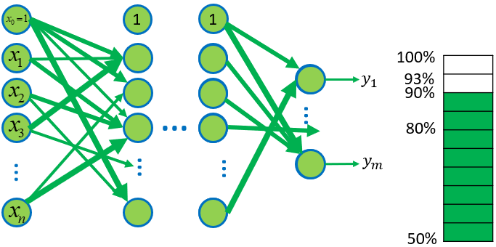
Omission of less significant weights
After training, only a minimal reduction in the accuracy of the neural network is achieved by dropping the weights of minor importance, in exchange for a significant reduction in the number of parameters.
In some cases (e.g., extreme learning machine, more typical for wide structures), a partially coupled ANN can achieve competitive learning speed by adding and subtracting weights from the initial state even using CPU.
In between dropping weights, it may be worthwhile to retrain the model, in which case other paths may be strengthened to take the role of the dropped links, in which case the final accuracy is less degraded.

Slide 47
Neuroevolution
The essence of the method is to optimize the structure of the network in addition to the parameters.
This is true automatic machine learning for neural networks.
Advantage:
Optimal structure generation
Automatic operation
Disadvantage:
Resource intensive
Simplest case is when individual neurons and the connections between them are modified by an evolutionary algorithm.
1
1
1
1
1
1
1
$${\hat{y}}_{1}$$
$${\hat{y}}_{1}$$
$${\hat{y}}_{1}$$
$${\hat{y}}_{1}$$
$${\hat{y}}_{1}$$
…
…
…
…
…
$${\hat{y}}_{m}$$
$${\hat{y}}_{m}$$
$${\hat{y}}_{m}$$
$${\hat{y}}_{m}$$
$${\hat{y}}_{m}$$
Under development (explorable): optimization through multi-level mapping that can use its own substructures. (further theory: genetic programming) Here too, it is worth working with structured input data.

Slide 48
Grouping by signal flow
Feedforward
Recurrent
Cellular
Feedforward neural networks
Use of:
fast processing of time-independent data,
non real-time accurate processing of time-dependent data
A cellular neural network is a network where there is a connection only between neighboring units.
Usage:
mainly image processing
Recurrent neural networks
Use of:
fast processing of time-dependent data

Slide 49
Grouping of certain layers
Different layer types have been developed for each (sub)task
1 layer usually contains the same type of neurons
Evaluation
Input
Output
Fully coupled layer
Partially coupled layer
Activation layer
Link layers (to link more than 2 layers)
Convolutional
Pooling layer
Reconnected layer
Memory cell layers
Highlighting type (ROI, Attention)
Training specific
Normalization layers
Batch normalization layer (on sample batch)
Batch normalization layer (on individual samples)
Regularization layers
Noise generation layers (random noise addition)
Dropout layer: Punctuated (random neurons) or Contiguous (random but contiguous neurons)

Slide 50
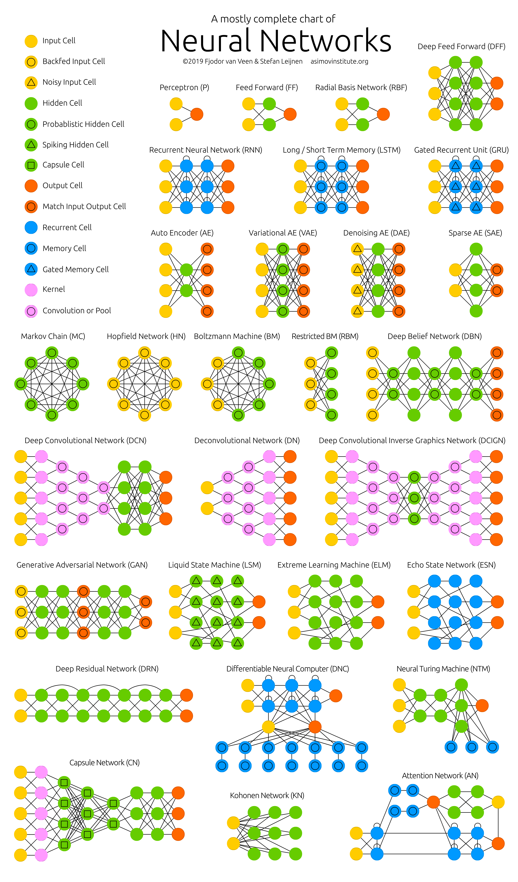
An overview of NNs
Different neural networks have been developed for different tasks
Source

